Slide 1

Why do Y’s: An Intro to Y-STR Testing
AK Scientific Crime Detection Laboratory - 2018

Slide 2
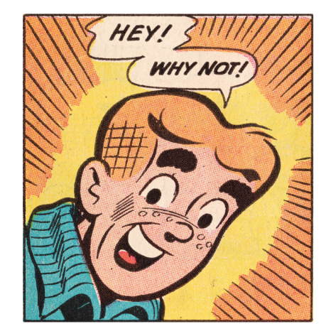
This presentation will cover:
Some DNA basics
Pros and cons of typical DNA testing versus Y-STR testing
What to expect in a Y-STR report

Slide 3
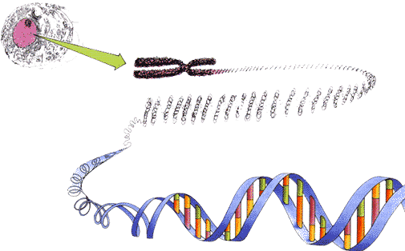
Remember high school biology…
DNA is found in the nucleus of the cell
Half of your DNA comes from mom half from dad
  This is what makes a persons DNA unique to them
  Traditional (autosomal) DNA testing and comparison relies on this uniqueness

Slide 4
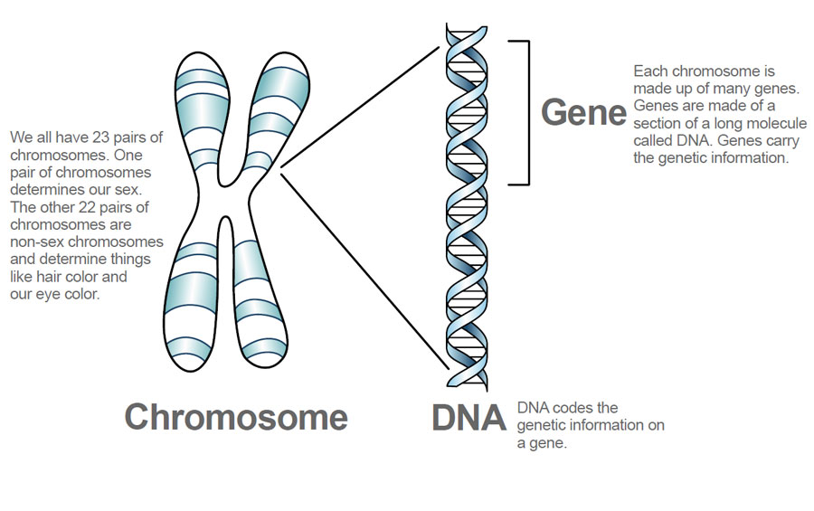
Remember high school biology…

Slide 5
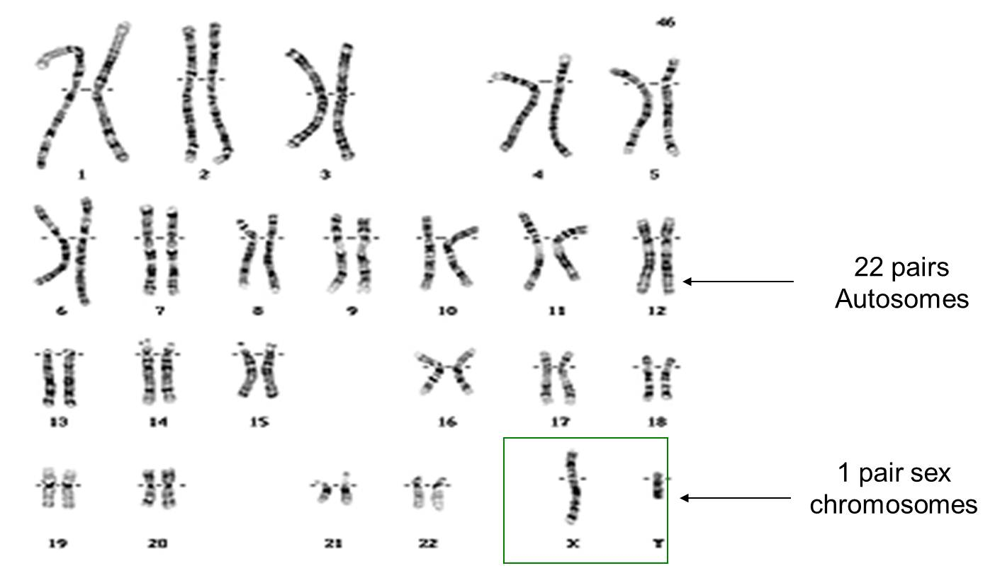
Remember high school biology…
22 pairs of autosomal (not-sex) chromosomes – “look alike” for male and female, but they have lots of other information
1 pair of sex chromosomes – the Y chromosome MUST come from a male

Slide 6
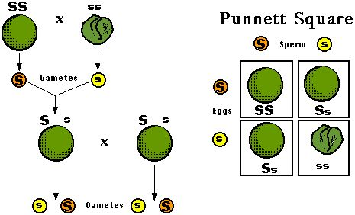
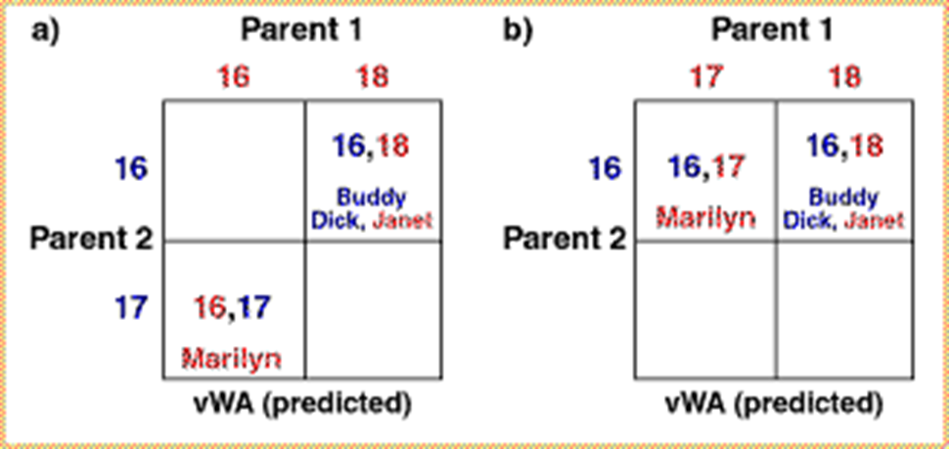
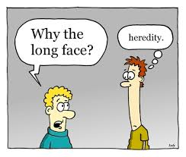
DNA basics: inheritance
Notes:
Mendel and his peas

Slide 7
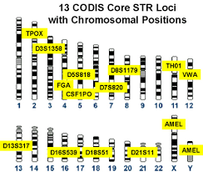
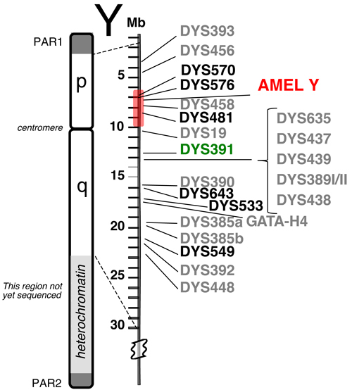
Forensic DNA testing looks at a set of markers found on specific chromosomes
Typical STR testing looks at a few markers on each of many (24) places
Y-STR testing looks at many (23) markers on just the Y chromosome

Slide 8
Advantages to typical DNA analysis: single source profiles…
Typical STR Profiles
Y-STR Profiles
Usually very, very rare (1 in 1000 times US population or rarer)
Can almost always distinguish between close relatives
May qualify to be searched in CODIS – chance to identify an unknown suspect
Usually a bit rare (1 in 100)
Can only occasionally distinguish between close male relatives
No function in CODIS for searching Y profiles – need to have reference samples

Slide 9
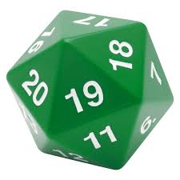

A typical DNA profile uses 24 markers and a Y-STR profile uses 23 markers, but the frequencies are very different!
Typical DNA: lots of possible combinations from many different chromosomes, so profiles tend to be very rare (picture below: chance of that roll is 1 in 7776)
Y-STR: all inherited in one “roll of the dice”, so fewer possible combinations, profiles less rare (picture below: chance of that roll is 1 in 20)

Slide 10
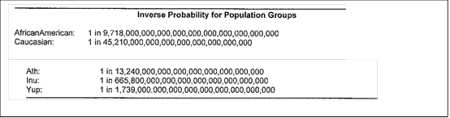
STR frequency results:
Y-STR frequency results:
Sample #123 | Caucasian database | African American database | Inupiat database | Yupik database | Athabaskan database | Total for combined populations
# of observations | 0 in 1494 | 0 in 1318 | 0 in 289 | 0 in 212 | 0 in 142 | 0 in 3755
Profile frequency (95% confidence interval) | 0.2003% (1 in 499) | 0.2270% (1 in 441) | 1.040% (1 in 96) | 1.408% (1 in 71) | 2.128% (1 in 47) | 0.0799% (1 in 1252)

Slide 11
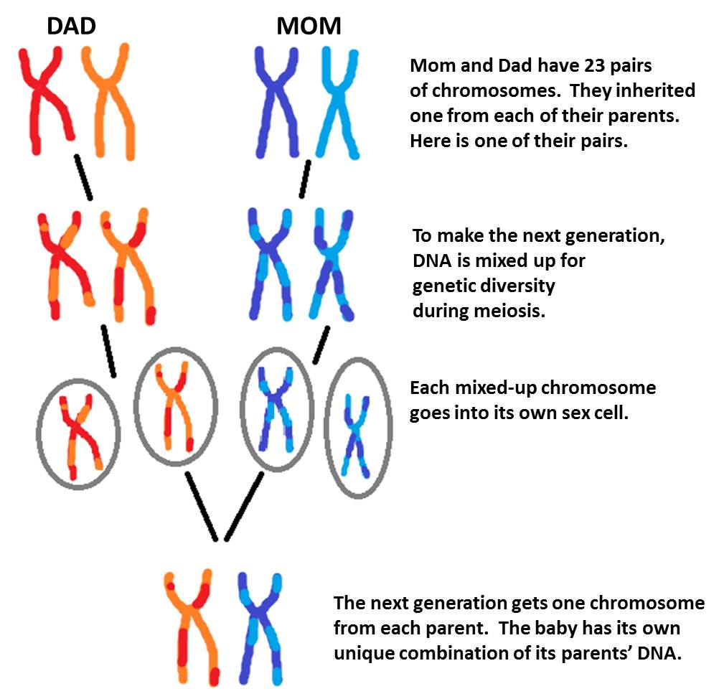
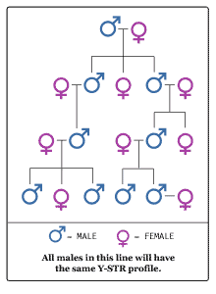
Why the Y chromosome isn’t good at distinguishing between close male relatives:
Autosomal inheritance mixes it up – much more likely to tell close relatives apart
Y chromosome is passed from father to son – with little/no shuffling, much less likely to tell close relatives apart
https://www.youtube.com/watch?v=vC92N5lndjE

Slide 12
Advantages to Y-STR Testing: mixed (male/female) profiles…
Typical STR Testing
Y-STR Testing
Minor male contributor gets “overwhelmed” (undetectable) when there’s less than 4:1 female to male DNA present – very common in sex assault cases
Requires more DNA to successfully perform testing
No female DNA is detected, so minor male is readily “seen”, no matter how much female DNA is present
Requires ~half as much DNA, so may be able to get a Y profile even when very little male DNA is present

Slide 13
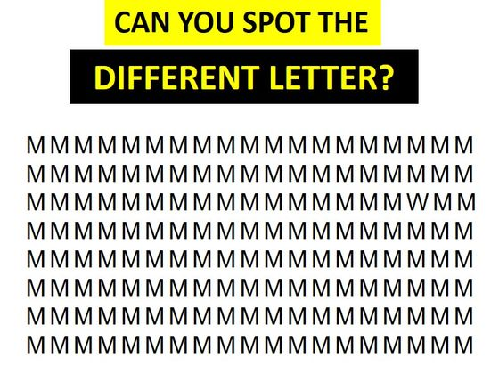
When you have a DNA mixture, a minor contributor can be hard to see…

Slide 14
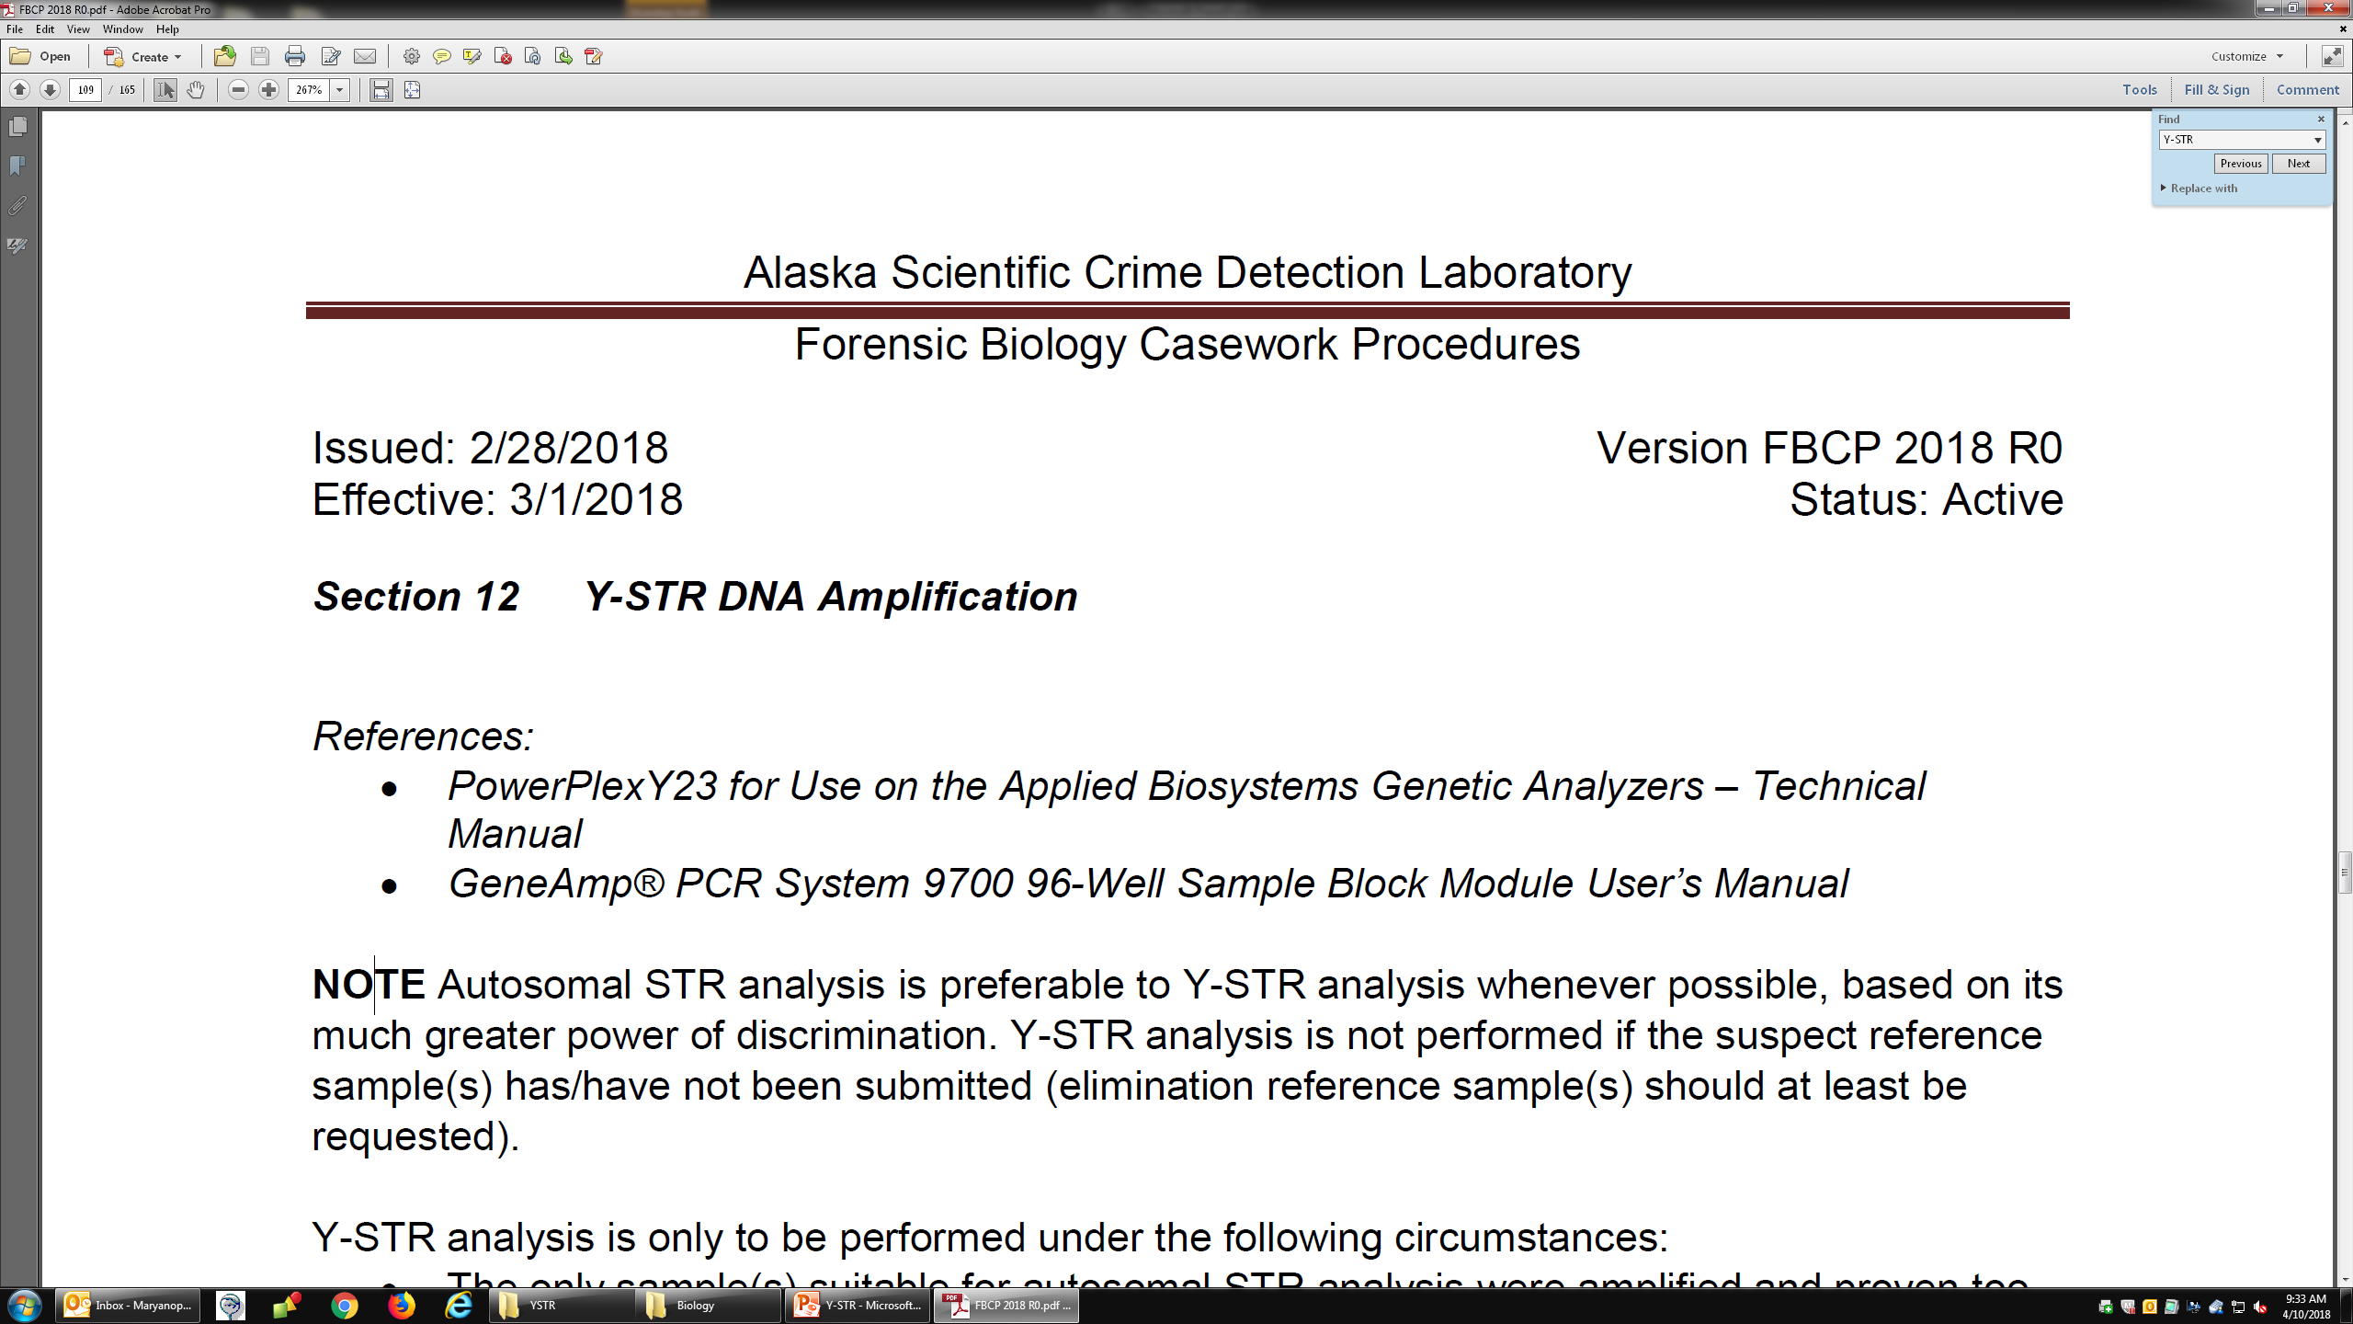
What is needed for Y-STR testing:
Questioned/crime scene (ex: from victim’s body) sample with male DNA present
  Ideally a sample likely to have only one male present
Reference samples from possible male contributors – consent partners as well as suspects
  No, seriously. Y-STR testing is useless without the references since Y-STR profiles cannot be uploaded to CODIS to search for a suspect

Slide 15
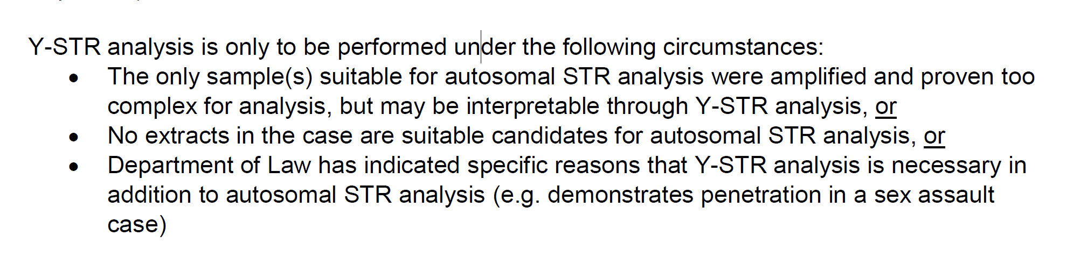
Y-STR’s in Alaska
Notes:
Taken directly from our SOP

Slide 16
What’s included in a Y-STR testing report?
Comparisons between questioned (crime scene) samples and reference samples:
  Profiles don’t match - excluded
  Profiles match – included - could be that person or a close male relative
  Inconclusive (either not enough DNA to get a profile, or mixture of multiple males that is too complex to interpret)
If there’s an inclusion, the questioned profile will be searched in a Y-STR database (such as US Y-STR) to determine a profile frequency.
  Counting method – how many times have we already seen this Y profile in the database?
  Broken out by population subgroups, including at least Caucasian, African American, and Alaska Native
  Database is for frequencies only – not an identity search

Slide 17
Y-STR Report wording
Inclusion
  The DNA profile from this sample matched the Y-STR profile from John Doe. Therefore, assuming a single source Y-STR profile, John Doe, and all his paternal male relatives, cannot be excluded as the source of DNA detected in this sample. This Y-STR profile is not expected to occur more frequently than 1 in 48 male individuals

Slide 18
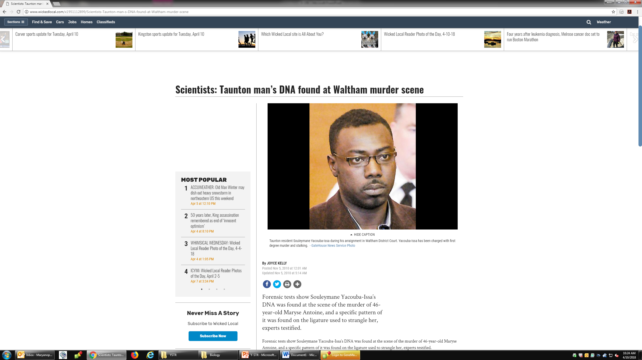
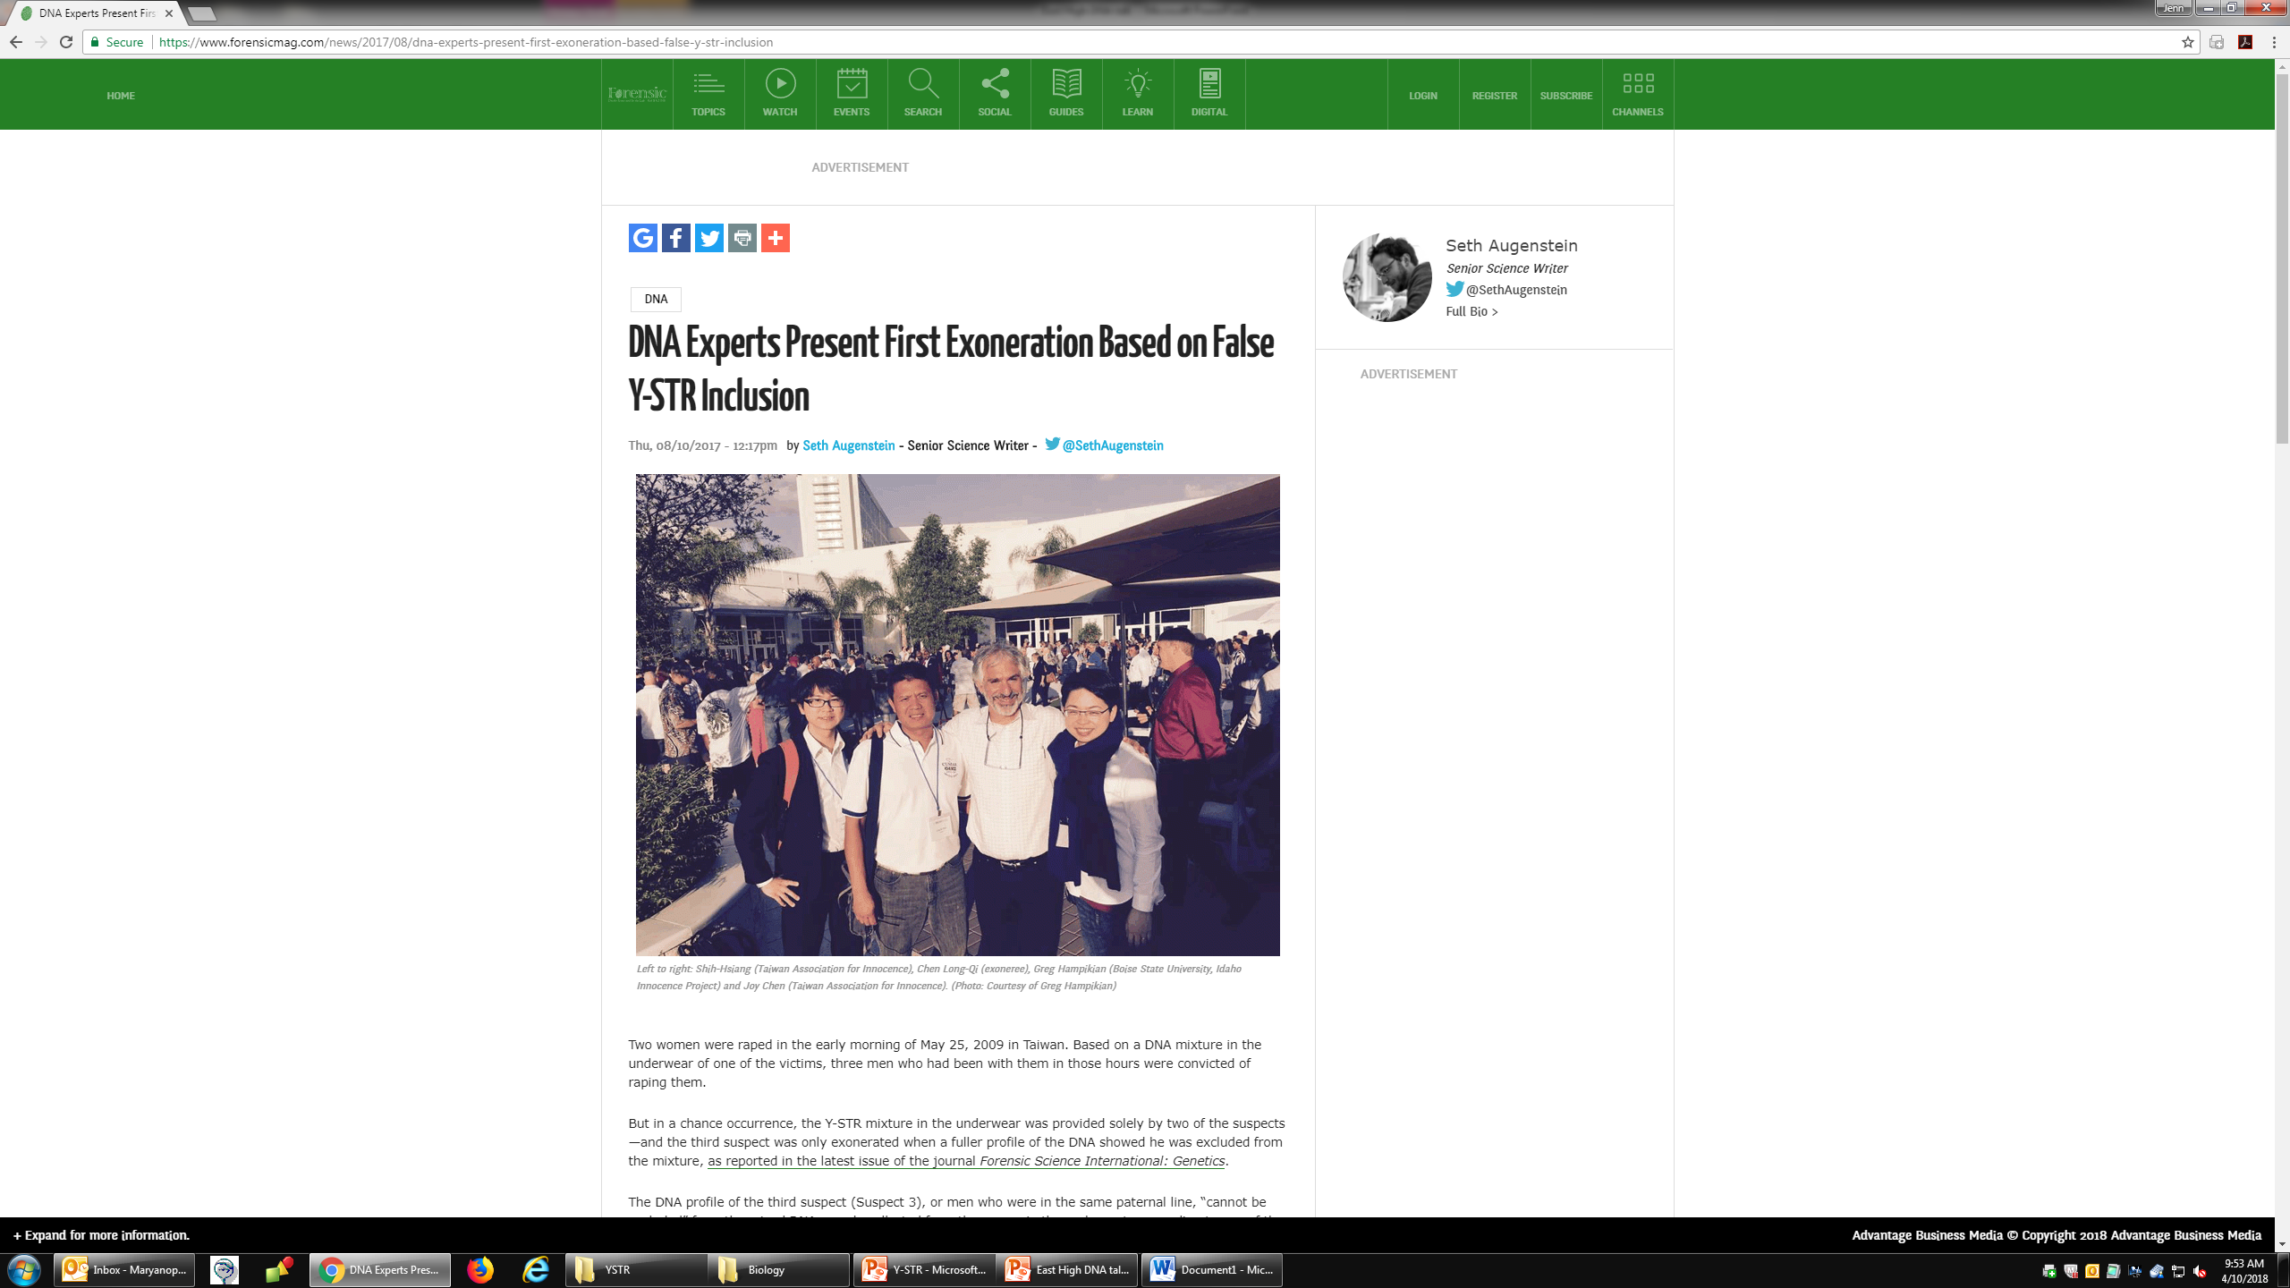
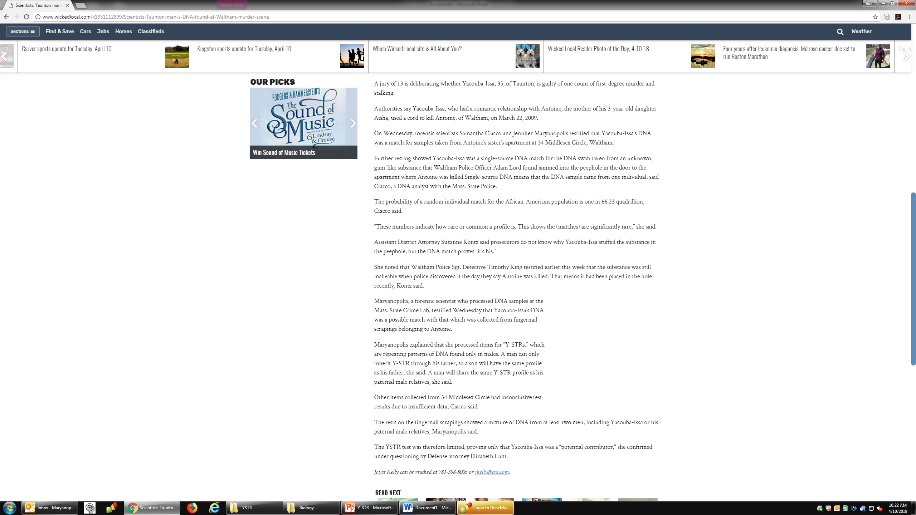
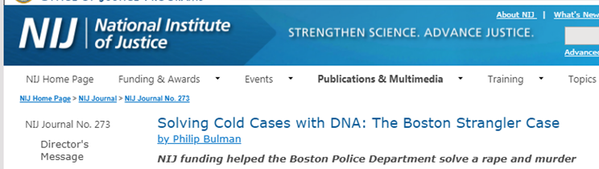
Y-STR’s in the news
(3)
(1)
(2)
Notes:
1: rape in tawain 3 males convicted (17 loci) YSTR profiles innocence project showed that the mixture of males could be accounted for by only 2 of the males (the third male shared alleles) when sample run using the expanded 23 Y kit the 3rd male was EXCLUDED
2: 1960’s Desalvo (sus) admitted to raping and killing 11 women he then recanted this. Reran sample from one of the victims and compared YSTR profile to the sus nephew (since unchanged from generation to generation) matched then exhumed sus body and confirmed this 2013

Slide 19

Any questions??
Refer to the AK SCDL website: https://www.dps.alaska.gov/Comm/CrimeLab/Forensic-Biology/DNA
Please contact Forensic Biology at the Alaska Scientific Crime Detection Laboratory

