Slide 1

Subgrantee Monitoring Process
Programmatic Onsite Reviews, Financial Desk Reviews & Ongoing Checks
An overview of the new CDVSA monitoring processes:
-OAT Levels
-Ongoing Checks
-Onsite Reviews & Financial Desk Reviews (FDRs)
Programmatic Monitors: Morgan Stonecipher & Jen LaRoe
Financial monitors: Chris Hardin & Anna Ramirez
Notes:
NOTE:
To change the image on this slide, select the picture and delete it. Then click the Pictures icon in the placeholder to insert your own image.

Slide 2

AGENDA
1
The Purpose of Monitoring
2
OAT Level Process
3
Continuous Monitoring
4
The Programmatic Onsite Reviews
5
The Financial Desk Reviews
6
Question & Answer Time
Notes:
Use note cards to capture questions that arise during the presentation. We will address any questions that were not answered throughout the course of the presentation at the end.

Slide 3

THE PURPOSE OF MONITORING
Notes:
Ensure compliance with rules, regulations, and requirements
Safeguard Federal funds against fraud, waste, and abuse
Help identify actual and potential issues
Identify technical assistance and training needs
Ensure follow-up on issues and corrective actions

Slide 4


Why Review?
CDVSA is the pass-through agency for federal grants funds and is required to monitor subgrantees.
We review for compliance:
Fiscal
Administrative
Programmatic
CDVSA monitoring assists subgrantees in meeting grant requirements and other applicable statutory regulations.
Notes:
CDVSA, as the pass-through agency for federal grants funds, is required to monitor its subgrantees to ensure compliance with their grant award agreements and other applicable statutory regulations.
Reviewing aspects of fiscal, administrative, and programmatic compliance is part of CDVSA’s monitoring process and is generally used to assist subgrantees in complying with grant requirements.

Slide 5
We review for:
Grant-specific requirements:
  VOCA, SASP, and FVPSA (grant award conditions)
Federal funder requirements:
  2 CFR 200, 45 CFR 75, DOJ guidelines, and U.S. OCR requirements
Workforce Labor Laws:
  US DOL, AK DOLWD
Alaska state-funding requirements:
  2 AAC 45, AAM
CDVSA regulations:
  13 AAC 90, 13 AAC 95
CDVSA policies and procedures

Slide 6

Operational Assessment Tool (OAT)
Process
Programmatic and Financial Monitors conduct OATs for each subgrantee in August of each fiscal year.
-Victim Services -Enhanced Services
Some considered factors are:
Amount of grant award(s)
Time since last review
Details related to de-obligation of funds
Punctuality and accuracy of reports
Budget adjustments
Findings from previous audits and CDVSA programmatic and financial reviews
Length of time prominent staff have been with the agency (such as ED and financial officer)
Level of communication with CDVSA
Notes:
For programmatic, it helps set our schedule for the year and determine if visits are 2 years apart or more or less frequent.
For financial, it helps determine the order of FDRs for the fiscal year.
HIGH RISK = higher priority for onsite and FDR
LOW RISK = lower priority for onsite and FDR

Slide 7
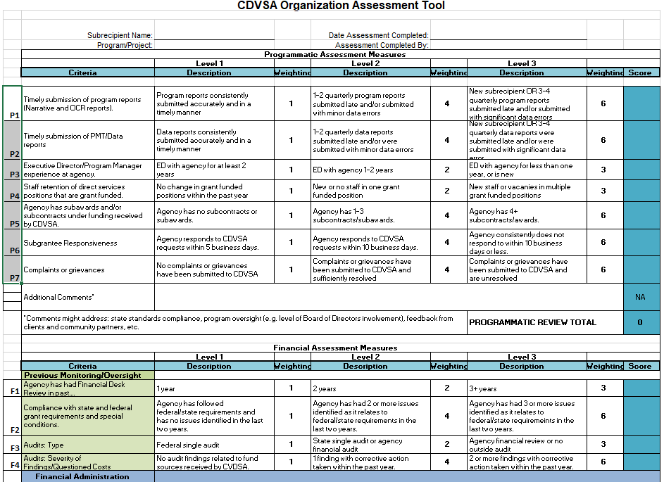

Slide 8
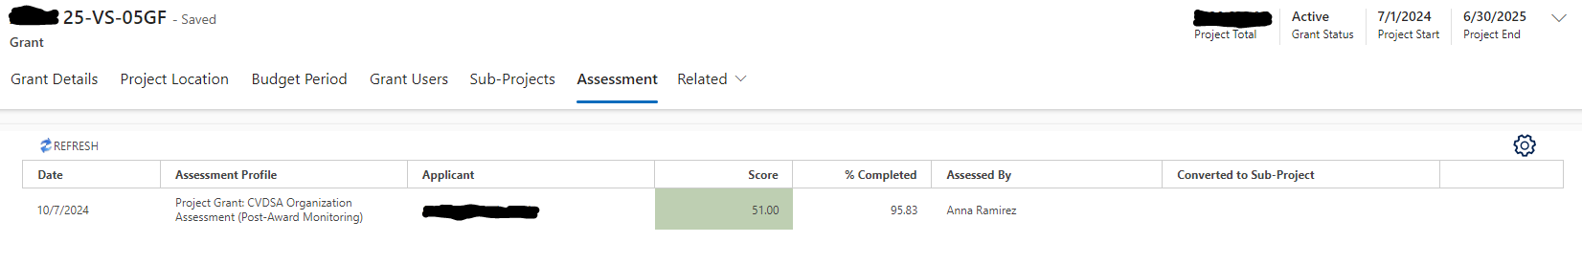
OAT Level is in GrantVantage
Award -> Related: Pick “Assessment” Tab
  If multiple Victim Service awards, under General Funds (GF) award
Click on score- can see entire OAT assessment
Green = 1, Yellow = 2, Red = 3

Slide 9
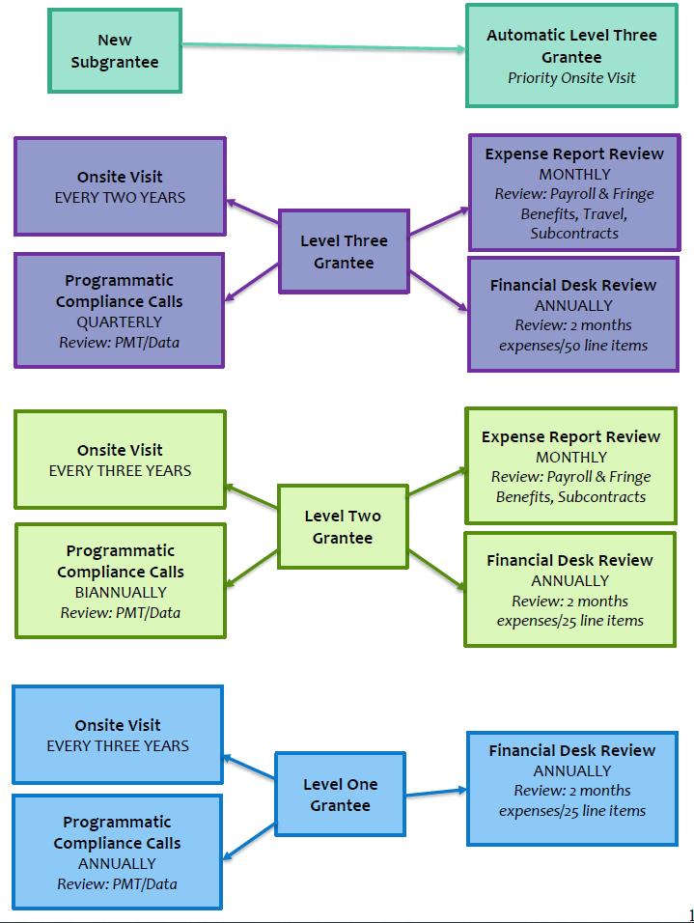
OAT
Score
Level 1
-least requirements
Level 2
Level 3
-most requirements
*Done annually, but score can change due to new circumstances

Slide 10


Continuous Monitoring
Programmatic
Quarterly Calls
Financial
Monthly Expense Report Documentation

Slide 11
Programmatic Calls
Occurs last month of Quarter
  Discuss Data & Service Provision
PCs set meeting for individual call
Will reach out more if needed
  EX: Data discrepancy
Level 1- 1 Call Required (Annual)
Level 2- 2 Calls Required (Biannual)
Level 3- 4 Calls Required (Quarterly)

Slide 12
Financial Expense Documentation
Occurs Monthly
  Attach required documentation to expense report in GrantVantage
ONLY if expense type occurred that month
Will ask for more if needed
  EX: Continual expense discrepancies
Level 1- No Documentation Required
Level 2- Payroll/Fringe, Subcontracts Required
Level 3- Payroll/Fringe, Travel, Subcontracts Required

Slide 13

THE PROGRAMMATIC ONSITE REVIEW

Slide 14
Planning Onsite Reviews for the Fiscal Year
Program Coordinators visit each subgrantee site based upon their OAT score.
*New Subgrantees are Priority Onsites
Level 1- Every Three Years
Level 2- Every Three Years
Level 3- Every Two Years
Results of OAT
(Year 1 of RFP)
Knowledge of Subgrantee Needs
Historical Monitoring by CDVSA
Year & Quarter of Onsite Visit
*Onsite Schedule can change based on changing circumstances
Notes:
The order and scheduling of programmatic site visits and financial desk reviews is determined by:
Results of RAs
Specific knowledge of individual subgrantee needs
Scheduling needs of subgrantees and CDVSA staff
PCs will contact subgrantees selected for programmatic site reviews to confirm dates of onsites.

Slide 15
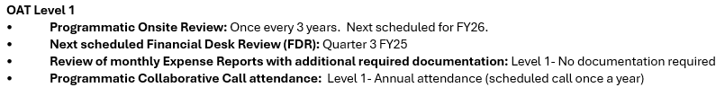
Receive OAT email by end of August

Slide 16

Before the Onsite Visit –Emails
8 WEEKS BEFORE VISIT (approx.)
Program Coordinator emails Executive Director (ED) to confirm specific dates of site visit.
4 WEEKS BEFORE VISIT (approx.)
Program Coordinator emails ED to request documents to review prior to arrival, and to inform ED of what to expect during the onsite. The following documents are emailed to the ED:
List of all documents regarding how agency functions (Policies & Procedures)
List of grant-funded personnel & volunteers
List of partnering agencies (MOUs)
What to Expect from a CDVSA Onsite (what we check, whom we interview)
2 WEEKS BEFORE VISIT (approx.)
ED emails Program Coordinator the requested documents.
IMPORTANT NOTE!
We are NOT an audit. Don’t rush to make something you don’t have!
Notes:
Pre-Onsite Letter: information regarding the onsite, including dates of the onsite, due date for submission of pre-onsite materials, and a list of personnel PC will need to interview.
Pre-Onsite Checklist: a list of all documents PCs need to review prior to coming on site. Subgrantees will email these documents, each as their own separate attachment.
CDVSA state or federal funded personnel/volunteer form: a form completed by the subgrantee to list all personnel funded by CDVSA grants, along with any volunteers used toward match.
Memoranda of Understanding form: a form completed by the subgrantee to list all current MOUs with community partners. From this list, 10 partners will be selected to receive surveys from CDVSA prior to the onsite. These surveys will give CDVSA an idea of how the subgrantee works within the community and where some potential gaps may be. If permission is granted by the community partner, the surveys are shared with the subgrantee.
Onsite Checklist: a list of what all PCs will need to view while on site. Subgrantees should pull these items into a central location (as able) to expedite the review process.
Tour of Program Checklist: a list of all the items PCs will look for while touring the facility.
These attachments outline what all PCs expect to see in subgrantee’s Policies, Procedures, and other documents, as well as within the program. If there are items the subgrantee is missing, it is not necessary nor advisable to create it in time for the onsite, unless they collaborate with PC first. Rushing to develop and implement a policy might result in having to do twice the work to fix it later. Rather, missing policies or procedures can be cited in the post-onsite letter, with an agreed-upon timeline for completion.

Slide 17

Before the Onsite Visit –Review
After documents are received from the Executive Director, the Program Coordinator:
Reviews materials and makes note of highlights and missing pieces
  The more clear the submission, the less likely we are to miss something
Coordinates with the Director on a schedule for the visit to ensure sufficient time for all onsite elements

Slide 18

The Program Coordinator interviews:
Executive Director/Program Lead
Financial Lead
Shelter Manager (if applicable)
CDVSA Grant-Funded Staff Member(s)
Board Chair
Additional staff, as needed (e.g. CAC Manager)
The Onsite Visit - Meetings
The Program Coordinator reviews:
Personnel Files
  Hiring Paperwork
  Training record/plan
  Performance evaluations
Storage of personnel documents
  I-9, Background Checks
Intake/Welcome Packet
Notes:
PC will conduct interview with Executive Director, Financial Agent, Shelter Manager (if applicable), CDVSA grant-funded staff member(s), and Board Chair.
PC will review personnel files for all grant-funded personnel to ensure each contains necessary documents.
PC will review financial processes to ensure internal controls are followed and that there is a segregation of duties.
EX: Process of requesting travel, purchase orders, delineation of personnel time, etc.
Verifying the delineation of coding for CDVSA funds coming in and going out.
PC will review all MOUs to verify they have all necessary elements.
PC will review past 3 Board packets to ensure meetings are conducted properly, that the Board is kept apprised of how the agency is functioning, and that the Board is fulfilling their fiduciary duties.

Slide 19

The Program Coordinator tours the facility to verify:
Personnel files kept locked and only accessible to appropriate personnel
Children and adult files kept separately
Adequate security, safety, and sanitation for adults and children
Participants have independent access to individual locking medication storage
Emergency protocols are posted, with all necessary elements
Civil Rights / non-discrimination information posted and also included in agency outreach materials
Supply of basic necessities available for participants
The Onsite Visit –
Facility Tour
Notes:
PC will tour the facility to verify:
Personnel files are locked and only accessible to appropriate personnel.
Background checks and I-9s are stored separately.
Children and adult files are separate, and locked, only accessible to appropriate personnel.
Adequate security, safety, and sanitation, for adults and children.
Shelter facility has adequate security including a secure (outdoor?) play area
Participants have independent access to individual locking medication storage.
Emergency protocols are posted, with all necessary elements.
Civil Rights: non-discrimination is posted and readily available in agency materials/brochures/etc.
Supply of basic necessities available for participants.
Not necessarily outdoor, and I think we can roll this into the above bullet.

Slide 20


The Onsite Visit –
Exit Interview
The Program Coordinator and Executive Director meet at the close of the onsite visit and discuss:
Areas of success and achievement
Items for Corrective Action (or potential)
  We will meet and discuss all noted items BEFORE we send out our post-onsite letter
Notes:
will review findings/potential findings from pre-onsite and onsite review with ED.
PC will review highlights/areas for improvement from Community Partner Surveys.

Slide 21

Post-Onsite Letter Prepared
* Overview of the visit
* List of items with required corrective action
* Timeline for completion
-Can always request extension
After the Visit
Post-Visit Letter Sent
* To Director & Board Chair
* Within 8 weeks
* Deadline for correction generally 6-8 weeks from issuance of letter
Closeout Letter Sent
* Completion of required corrective actions tracked
* When satisfied, letter of completion issued
* Programmatic site review officially closed
Notes:
PC will complete Post-Onsite Letter with an overview of the onsite visit and a list of findings with required corrective action as well as agreed upon timeline for completion.
PC will email Post-Onsite Letter to Executive Director and Board Chair within 4 weeks of onsite. Letter will state deadline for completion of required corrective actions, generally 6 weeks from issuance of letter.
PC will track completion of required corrective actions. Once all have been satisfied, PC will issue a Letter of Completion to subgrantee, officially closing their Programmatic Site Review.

Slide 22
FREQUENT FINDINGS FROM ONSITE VISITS
CIVIL
RIGHTS
VOLUNTARY SERVICES
CONFIDENTIALITY
PARTICIPANT FILES
PERSONNEL
Staff Training
Curfew
Contacting Law Enforcement or Office of Children Services without a Release of Information
Adult and Children files Separate
Delineated Timesheets
EEOP Form
Intoxication
Training Documentation Missing or Incomplete
Over - Documentation
Protected Classes
Participation
Notes:
CIVIL RIGHTS
Staff training
Completing exempt form for EEOP
Updates to protected classes
VOLUNTARY SERVICES
Curfew
Intoxication
Participation
CONFIDENTIALITY
Contacting LE or OCS without ROI
PARTICIPANT FILES
Separate for child and adults
Overdocumentation
PERSONNEL
Files Missing required training documentation
Delineated timesheets

Slide 23

THE FINANCIAL DESK REVIEW (FDR) PROCESS
Notes:
FDR steps to subgrantees doc

Slide 24
Planning FDRs for the Fiscal Year
Knowledge of Subgrantee Needs
Scheduling Needs of Subgrantee & CDVSA Staff
Quarter of Financial Desk Review
Results of OAT
Each year, a subgrantee will have a FDR unless the risk assessment and other factors dictate the need for more frequent review of a program’s finances.
Notes:
Financial Monitors:
Shannen reviews all Federal subawards (VOCA, SASP, FVPSA )
Kelly reviews all General Fund subawards (VS, BIP, PBP, CR, CBPPP), and VAWA
Each year, a program will have FDR unless the Risk Assessment and other factors dictate the need for more or less financial desk review.

Slide 25


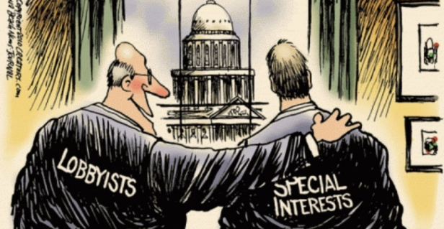

Key Financial Areas to Review
Personnel Time & Activities
Financial Reports
Unallowable & Allowable Costs
Match (Cash & In-kind)
Level 1- 2 Months Expenses/up to 25 Line items
Level 2- 2 Months Expenses/up to 25 Line items
Level 3- 2 Months Expenses/up to 50 Line items
You do NOT need to re-submit expense documentation (Level 2 & 3)
Notes:
Personnel time and activities – Appropriately documented and allocated
Allowable and Unallowable Costs
Match (cash and in-kind, if applicable) – Appropriately documented, recorded, allocable
Financial reports – Internal and external; supported by accounting records, timeliness

Slide 26

FDR Process Timeline - Prepare
During your Assigned Quarter:
Subgrantee receives FDR notification letter (through email) asking for general ledger
  Letter identifies selected grant(s) and selected month(s)
  Have one week to submit ledger
Notes:
Financial Desk Review Process
1. Financial Desk Review Notification Letters along with a Source Document Request Checklist will be emailed to the subgrantee’s primary contact at least 30 days prior to the scheduled review. The subgrantee’s Board chair and designated CDVSA Program Coordinator will be included in this notification.
2. The subgrantee will have at least 30 calendar days to prepare their financial reports, gather their source documents outlines on the checklist, and ask clarifying questions. The CDVSA Administrative Officer or Grants Administrator will work with each subgrantee and follow up, by either phone or email, to ensure subgrantees understand the process and expectations.
3. Subgrantees will submit their financial documents to the CDVSA Administrative Officer by close of business (4:30 pm AKST) on the specified due date, usually the 1st of the month.

Slide 27
Staff Documents for Fiscal Accountability & Match
VOLUNTEER TIME
SALARIES
Event sign-in sheets tracking time and attendance OR signed timesheets with supervisor’s signature
Documentation of how monetary value of volunteer time is calculated
Signed timesheets with supervisory approval
Quarterly payroll returns
Payroll register
Personnel file with salary/wage information
Cancelled checks/ Direct deposit schedule
FRINGE BENEFITS
Paid invoices and receipts
Employer costs on payroll register
Notes:
All salaries and wages charged against subaward funds should be supported by signed timesheets & attendance records. It might also be useful to keep track of how much staff time was spent on different program areas, to measure progress towards work plan deliverables and management plan implementation.
All volunteer hours used as in-kind match should be supported by signed timesheets and/or attendance records.
The most important information to track is the number of hours of work completed and the kind of work being done.
Also, it is important to have a defensible system for calculating the monetary value of volunteer time.

Slide 28
Process Documents for Fiscal Accountability & Match
TRAVEL
CONTRACTS & CONSULTANTS
Authorization/reimbursement requests
Paid invoices and receipts
Per diem rates (applicable for area)
Mileage calculation
Reconciliation of advances to payments
Have established procurement process and adhere to agencies policies and procedures
Contract and scope of work, including deliverables
Signed agreements
Consultants are not compensated more than $81.25/$650 per day, unless the Consultant Pay Exemption Form has been approved by CDVSA

Slide 29
Purchase Documents for Fiscal Accountability & Match
SUPPLIES & COMMODITIES
Equipment
Purchase orders
Paid receipts and invoices
Donated Supplies, i.e., in-kind donations
Connection to Budget Narrative
Have established procurement process and adhere to agencies policies and procedures
Purchase orders
Paid invoices and receipts
Have ledger keeping track of depreciation for 3 years after
Notes:
Purchase orders
●Packing slips
●Paid receipts and invoices
●Donated Supplies, i.e., in-kind donations
●Connection to annual work plan

Slide 30

FDR Process Timeline - Process
5 Business Days After Ledger Received:
Subgrantee receives email with: Ledger returned with highlighted line items for expense documentation FDR checklist of documentation to submit Subgrantees have one month to submit documents
Once received, CDVSA has one month to review
Notes:
Financial Desk Review Process
4. The financial review of received documents will be completed within 3 to 7 business days depending on the amount of material there is to review.
5. Once the material has been reviewed the CDVSA Administrative Officer or Grants Administrator will contact the subgrantee to schedule an “exit interview” between the 5th to 7th day and discuss potential findings. The CDVSA Program Coordinator may also join in on the exit interview.

Slide 31

FDR Process Timeline - Complete
If in Full Compliance:
CDVSA will send out FDR Closeout Letter
No Exit Interview will be scheduled, but subgrantee can request one
If Items for Corrective Action are found:
CDVSA staff will contact subgrantee for Exit Interview to discuss
Subgrantee will receive Post-FDR letter noting the corrective action items needed and the deadline for receiving those items
CDVSA reviews items, and if in full compliance, sends FDR Closeout Letter
Notes:
Financial Desk Review Process
6. Following the exit interview, a Financial Monitoring Compliance Review Report will be provided to the subgrantee within 3 to 5 business days. This report will identify findings and set an expectation for how the subgrantee can come into compliance. If there are no findings this will complete the Financial Desk Review.
7. The subgrantee will have up to 60 calendar days from receiving their Financial Monitoring Compliance Review Report to submit proof of compliance. Proof of compliance will be submitted to the CDVSA Administrative Officer. (*Examples)
8. The CDVSA Administrative Officer or Grants Administrator will review the additional material submitted by the subgrantee and submit their recommendations to the Program Coordinator within 3 to 5 business days.
9. If the Program Coordinator agrees with the recommendation, then the Administrative Officer or Grants Administrator will email the subgrantee a Financial Compliance Satisfaction letter within 2 business days and this will complete the Financial Desk Review.
10. If CDVSA determines the subgrantee continues to remain out of compliance, then the Financial Desk Review process will continue and special conditions for the subgrantee will be considered.

Slide 32

Programmatic TA Ideas & Questions
Ideas for TA:
Grant Allowability
DV Services vs. SA Services
Data Tracking & Usage

