Slide 1

Prevention

Slide 2
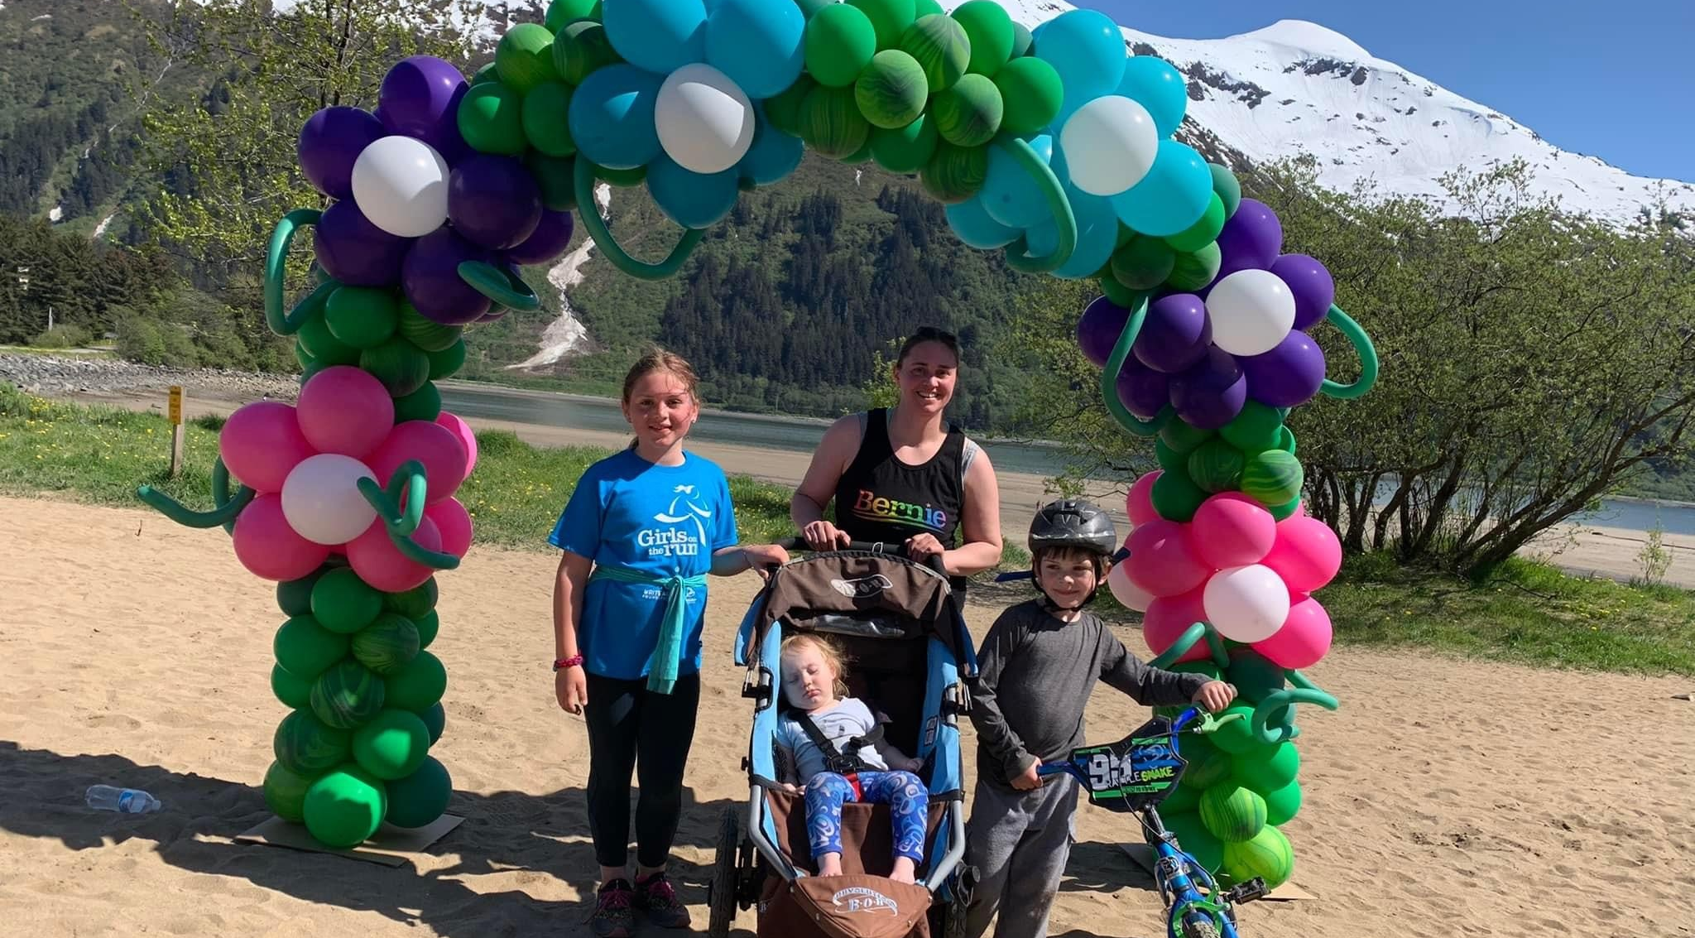
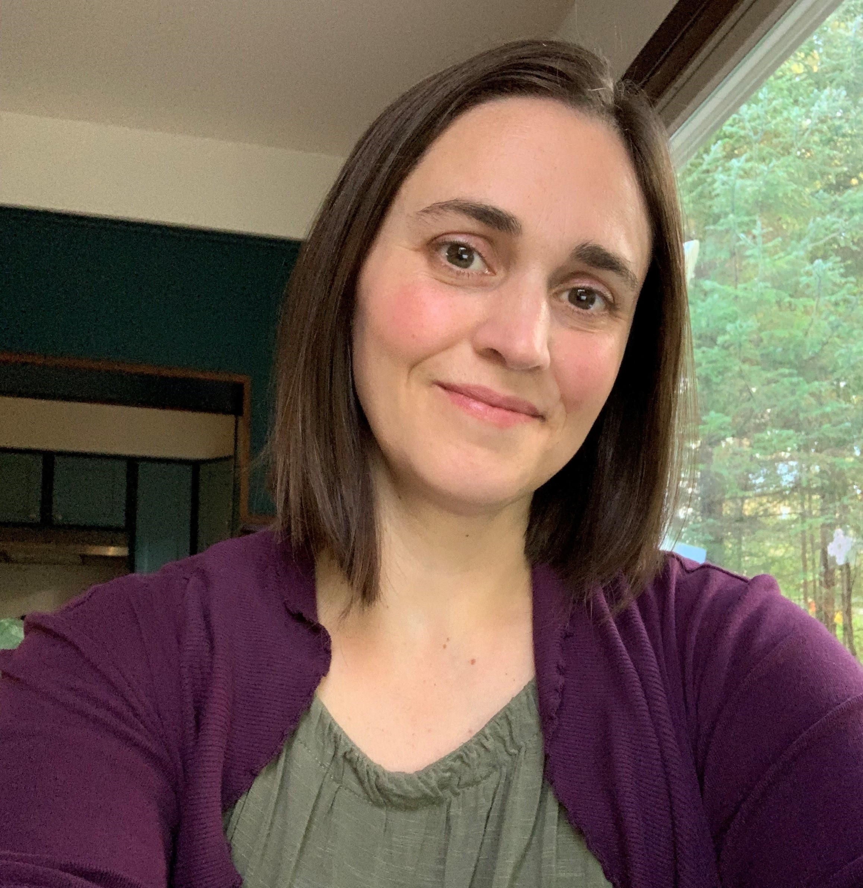
Danielle Redmond
AWARE & HTL in Juneau
Master’s at UAF
Mother of 3

Slide 3
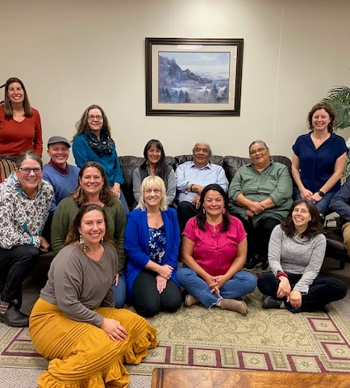
Prevention Summit
In Juneau: at Elizabeth Peratrovich Hall
Week of March 3rd, 2025
Virtual Option: streaming for those who can’t attend but plan on sending 1-2 people
Partnerships across the state
Shared Risk & Protective Factors
Details are still being finalized

Slide 4

Prevention RFP
Spring 2025

Slide 5
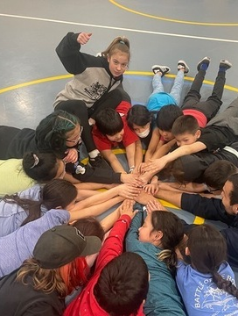
Pathways Plan – a work in progress
Goal #1 – Basic Needs
Goal #2 – Alaska supports communities that build connection and healing
Goal #3 – Youth
Goal #4 – Prevention Infrastructure

Slide 6

Data & Reporting
Your data matters.
  Time consuming, tedious, difficult to coordinate across staff.
  Oversight increasing at the federal level
  Competitive funding environment
This is how we develop good strategy, inform decisions, and advocate for funding.
  We do use it! Thank you!
  Surprises are useful
  Increased interest in prevention
We all have a role to play in this process.
Telling our stories is important!
  (with care)
Sharing your data back to you

Slide 7

CDVSA Outreach
Partnering with Walsh | Sheppard for statewide outreach and connecting people to resources
First year of continuous presence
Broad picture of the media landscape in AK.
Research – social norms campaigns impact perception but don’t impact behavior as much as we thought
Responses – Talk Now Talk Often gets a lot of traction! Parents are looking for resources. Signs of DV gets a lot of traction. Consent messages struggle the most – room to improve.
New landing pages so we can track engagement more
Presence at NYO
Sharing content across agencies

Slide 8
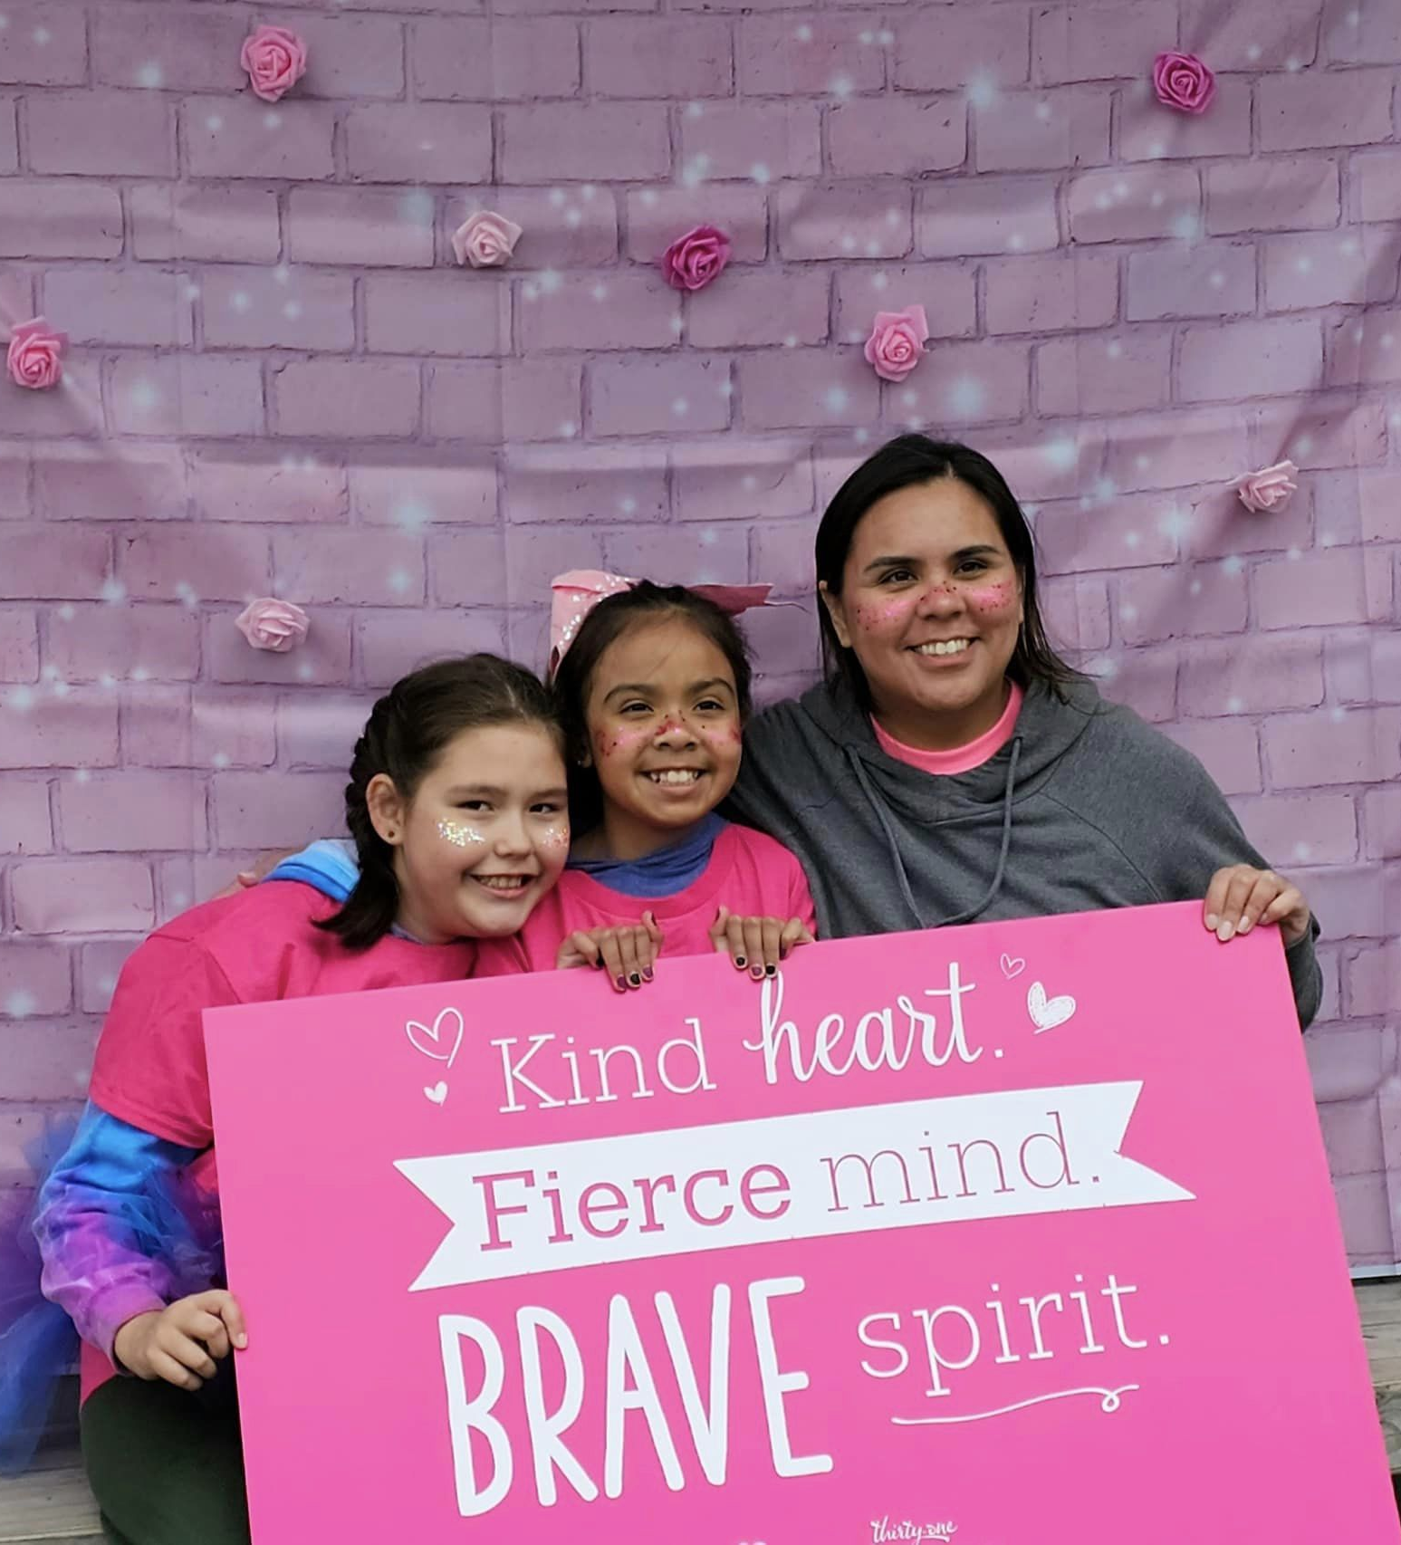
Annual Reports
13 communities
7,015 community members attended events
7,396 youth attended prevention presentations
  898 youth participated in prevention strategies
  99 youth peer mentors or co-facilitators
  69 youth coalition members
The most common risk factors: teen dating violence, gender norms, mental health, child abuse
The most common protective factors: social-emotional skills, resiliency, positive community norms, and connecting youth to caring adults.

Slide 9
OMB metrics
Target #1: Increase the number of strategies implemented by CDVSA Prevention programs that address shared risk and protective factors (including social determinants of health). (Grantee reporting)
Target #2: Increase the number of youth who participate in CDVSA prevention planning. (Grantee reporting)
Target #3: Decrease the number of youth who experienced physical dating violence during the past year. (YRBS)
Target #4: Decrease the percent of individuals who experienced intimate partner violence in the past year. (BRFSS)

Slide 10
Community Needs Assessments

Slide 11
Community Needs Assessments

Slide 12
Data sources:
CDVSA dashboard
Department of Public Safety Crime Reports and Felony Sex Offenses Report
Alaska Victimization Survey
Department of Public Health Data Hub
Behavioral Risk Factor Surveillance System
Youth Risk & Behavior Survey
Alaska ACES study
Maternal Death Review Recommendations
National Network on Domestic Violence & Sexual Assault point in time survey

Slide 13
Requests for Assistance from programs, coalition partners, and community members
Bystander program
Bullying
Sexual harassment 3-5th grade
Accountability
Lack of Law Enforcement
Digital & online safety

Slide 14
Questions?
Danielle Redmond
Prevention Program Coordinator II
danielle.redmond@alaska.gov
907-465-5015

